Slide 1

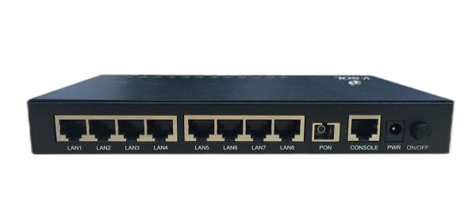







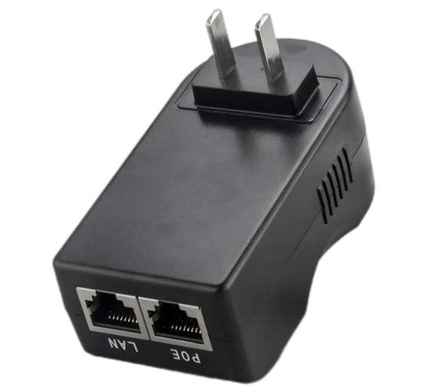


V2808PD-ZG
1*GPON+8FE ONT
Key Features:
ZTE Chipset
High Performance Solution
PD POE Supply
+24~+57V DC
Wide Working Temp
-30℃～+60℃
O&M Mode:
EMS/Web/SNMP/CLI
Introduction:
V2808PD-ZG(1*GPON+8FE(PD POE)) ONT is designed for fulfilling FTTH request of telecom operators, internet access of SOHO. This product is support GPON model, which has high performance, and the technology of layer 2 Ethernet switch as well. It is highly reliable and easy to maintain, with guaranteed QoS. Its GPON model is fully compliant to ITU-TG.984.x.
Application Chart:
WiFi Device
Internet
PSE Adapter
V2808PD-ZG
IPTV
OLT
PC
router
Splitter
VSOL product datasheet | Updated: 24 -11 - 2021 | Rev.2.0 | www.vsolcn.com

Slide 2
Hardware Parameter
Function Data
Dimension | 210mm×146mm×44mm(L×W×H)
Net weight | 1.4Kg
Operating condition | Operating temp: -30 ~ +60°C Operating humidity: 10~90%(non-condensed)
Storing condition | Storing temp: -30 ~ +85°C Storing humidity: 10 ~ 90% (non-condensed)
Power adapter | DC 12V, 1A, external AC-DC power adaptor
POE Supply | POE(PD): +24~+57V DC
Power supply | ≤8W
Interfaces | 8FE
Indicators | PWR, LOS, REG, LINK/ACT, SYS
Basic | Support MPCP discover&register Support authentication Mac/Loid/Mac+Loid Support Triple Churning Support DBA bandwidth Support auto-detecting, auto-configuration, and auto firmware upgrade Support authentication SN/Psw/Loid/Loid+Psw
Alarm | Support Dying Gasp Support Port Loop Detect Support Eth Port Los
LAN | Support Port rate limiting Support Loop detection Support Flow control Support Storm control
VLAN | Support VLAN tag mode Support VLAN transparent mode Support VLAN trunk mode(max 8 vlans) Support VLAN 1:1 translation mode(max 8 vlans) Auto VLAN detection
Multicast | Support IGMPv1/v2,IGMP Snooping Max Multicast vlan 8 Max Multicast Group 64
QoS | Support 4 queues,SP and WRR and IEEE802.1p
L3 | Support IPv4,DHCP/PPPOE/Static IP and NAT Support Static route
Interface Parameter
PON interface | 1GPON port(GPON Class B+) SC single mode, SC/UPC connector TX optical power: 0～+4dBm RX sensitivity: -27dBm Overload optical power: -8dBm Transmission distance: 20KM Wavelength: TX 1310nm, RX1490nm
LAN interface | 8 x 10/100Mbps Auto-negotiation RJ45 ports
Software Key Feature
Uplink Mode | Bridging and Routing mode.
ACL Rules | ACL, Spanning Tree
O&M | WEB/TELNET/OAM/OMCI Unified network management of VSOL OLT
Product Name | Product Description | Accessories
V2808PD-ZG | 8FE | AC-DC power adaptor: DC12V / 1A or PSE POE adaptor: DC:+24 or 48V
Official Website: https://www.vsolcn.com/ E-mail: sales@ftthcpe.com support@ftthcpe.com

